Slide 1
Weekly report: Feedback & Lidar – Assisted Controller
Week number: 09
Date: 25/11/2025
Supervisor: Prof. Dr.-Ing. David Schlipf
Group members: Mirza Dincer, Saurabh Pankaj Jha, Midhun Kanichattu Venu
Presenter: Saurabh Pankaj Jha

Slide 2
List of Contents
Tasks of the Week
Torque Controller
Torque Controller in ROSCO
Torque Controller of Optimus
Lidar-Assisted Controller effects on loads.
Coherence for Lidar-assisted Controller
Saurabh Pankaj Jha

Slide 3
Tasks of the Week
Calculating theoretical values for torque controller.
Understanding coherence to calculate how well lidar system measures.
Saurabh Pankaj Jha

Slide 4

Torque Controller
Torque controller aims to maximize aerodynamic power in region 2 and maintains the rated power constant in region 3.
It adjusts generator torque based on the generator speed, thus a relation between generator torque and generator speed is needed.
$$M_{G}=\underset{k}{\underbrace{\frac{1}{2}ρπR^{5}\frac{c_{P,\text{opt}}}{λ_{\text{opt}}^{3}{ r}_{\text{GB}}^{3}}}} Ω_{G}^{2}$$
Values for Optimus:
$$\left(R=80 \text{m} c_{P,\text{opt}}=0.45∗ λ_{\text{opt}}=8.5 r_{\text{GB}}=120\right)$$
* Not finalized
[1]
Saurabh Pankaj Jha

Slide 5
Torque Controller
Figure 1: Theoretical kOmega^2 for optimus
Saurabh Pankaj Jha

Slide 6
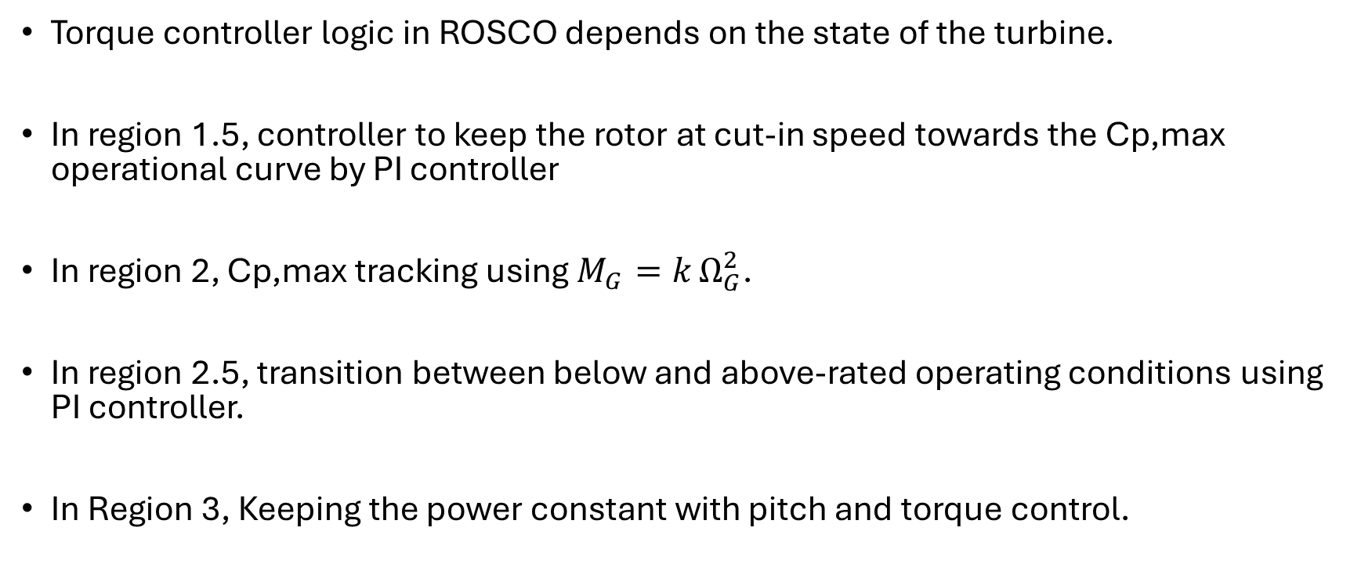
Torque Controller in ROSCO
Torque controller logic in ROSCO depends on the state of the turbine.
In region 1.5, controller to keep the rotor at cut-in speed towards the Cp,max operational curve by PI controller
In region 2, Cp,max tracking using $M_{G}=k Ω_{G}^{2}$.
In region 2.5, transition between below and above-rated operating conditions using PI controller.
In Region 3, Keeping the power constant with pitch and torque control.
Saurabh Pankaj Jha

Slide 7
Torque Controller in ROSCO
Inputs
Generator efficiency mechanical power -> electrical power
Above rated generator torque PI control saturation, [Nm]
Maximum torque rate (in absolute value) in torque controller, [Nm/s].
Maximum generator torque in Region 3 (HSS side), [Nm].
Minimum generator torque (HSS side), [Nm].
Minimum generator speed [rad/s]
Generator torque constant in Region 2 (HSS side), k value, [Nm/(rad/s)^2]
Wind turbine rated power [W]
Rated torque, [Nm].
Rated generator speed [rad/s]
Number of generator PI torque controller gains
Proportional gain for generator PI torque controller [-]
Integral gain for generator PI torque controller [s]
Power-maximizing region 2 tip-speed-ratio [rad]
Saurabh Pankaj Jha

Slide 8
Torque Controller for Optimus
Figure 2: Theoretical Torque controller for optimus
Saurabh Pankaj Jha

Slide 9
Lidar-Assisted Controller effects on loads.
Measures the incoming wind
Turning incoming wind speed signal to a rotor effective wind speed signal.
By rotor effective wind speed, pitch angle output from pitch controller will be adjusted.
As a result, blade pitch angle will be already set for incoming wind speed, unlike with the only feedback controller.
When blade pitch angle aligns with the wind speed, turbine can stand the gusts in more efficient way because wind will not push wind turbine as much, which will result in a less tower base moment.
Saurabh Pankaj Jha

Slide 10
Lidar-Assisted Controller effects on loads.
Figure 3: Example simulation for Lidar-assisted Controller
Saurabh Pankaj Jha

Slide 11
Coherence for Lidar-assisted Controller
What is coherence?
Coherence quantifies the spatial correlation of wind fluctuations between two points in the frequency domain.
It describes how much the wind at different parts of the rotor moves together
It shows how well lidar system measurement is where 0 indicates no correlation and 1 represents perfect correlation
IEC Kaimal model provides standard coherence specifications for wind turbine design and validation per IEC 61400-1
Role in Wind Turbine Control
  Load Prediction: Accurate modeling of blade and tower loads requires knowledge of how wind speed fluctuations are correlated across the rotor disk.
  Wind Field Generation: Turbulence models (e.g., Kaimal) use coherence functions to generate spatially correlated wind fields for simulation
  Lidar-Assisted Control: Coherence between the rotor-effective wind speed and lidar measurements affects the performance of feedforward controllers.
Saurabh Pankaj Jha

Slide 12
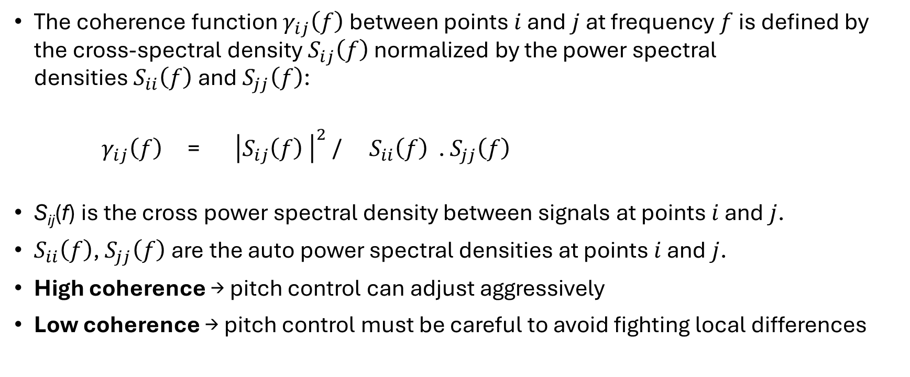
Coherence for Lidar-assisted Controller
The coherence function $γ_{ij}\left(f\right)$ between points $i$ and $j$ at frequency $f$ is defined by the cross-spectral density $S_{ij}\left(f\right)$ normalized by the power spectral densities $S_{ii}\left(f\right)$ and $S_{jj}\left(f\right)$:
$γ_{ij}\left(f\right)$ = ${\left|S_{ij}\left(f\right) \right|}^{2}$ / $S_{ii}\left(f\right)$ . $S_{jj}\left(f\right)$
S_{ij}(f) is the cross power spectral density between signals at points $i$ and $j$.
$S_{ii}\left(f\right)$, $S_{jj}\left(f\right)$ are the auto power spectral densities at points $i$ and $j$.
High coherence → pitch control can adjust aggressively
Low coherence → pitch control must be careful to avoid fighting local differences
Saurabh Pankaj Jha

Slide 13
Conclusion
Theoretical torque controller is ready to be applied to optimus turbine.
Understand how coherence value shows the performance of lidar system. Lidar-assisted controller will be adjusted to get better coherence.
Next weeks:
Apply torque controller to Optimus turbine if it is possible, then optimize the values
Run turbulent wind simulations with IEA 3.4 MW, in order to understand how to adjust lidar-assisted controller get better coherence.
Saurabh Pankaj Jha

Slide 14
Biblography
[1] D. Schlipf, "Lidar-Assisted Control for Wind Turbines I," Class Lecture, Topic: "Controller Design for Wind Turbines and Wind Farms," Wind Energy Engineering Master, Hochschule Flensburg, Flensburg, Germany, [17/11/2025].
Saurabh Pankaj Jha

